Slide 1
Hive
加入尚学堂，一起进步！

Slide 2
Hive
Hive2 beeline
Beeline 要与HiveServer2配合使用，支持嵌入模式和远程模式
启动HiverServer2 , ./bin/hiveserver2
启动Beeline
wangyue@wangyue-um:~/opt/hive/hive-0.12.0-cdh5.1.0$ ./bin/beeline
beeline> !connect jdbc:hive2://localhost:10000
默认 用户名就是登录账号 密码为空

Slide 3
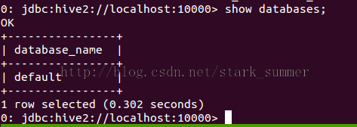
Hive
Hive

Slide 4
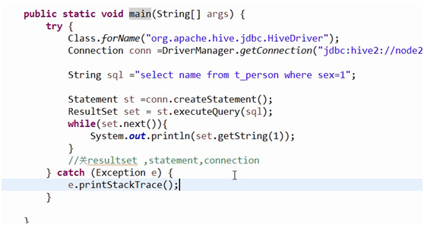
Hive
Hive jdbc

Slide 5
Hive
Hive正则匹配
CREATE TABLE apachelog (
host STRING,
identity STRING,
username STRING,
time STRING,
request STRING,
status STRING,
size STRING)
ROW FORMAT SERDE 'org.apache.hadoop.hive.serde2.RegexSerDe'
WITH SERDEPROPERTIES (
"input.regex" = "([^ ]*) ([^ ]*) ([^ ]*) \\[(.*)\\] \"(.*?)\" (-|[0-9]*) (-|[0-9]*)"
)
STORED AS TEXTFILE;

Slide 6
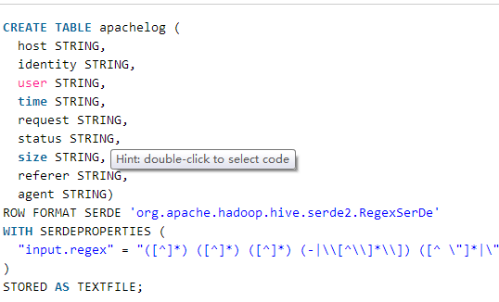
Hive
Hive正则匹配

